Slide 1
INFT 6903 Data Science
Week 6: Clustering (Machine learning)/Part I
Dr. Tolga Ensari
Department of Computer and Information Sciences
Arkansas Tech University
E-mail: tensari@atu.edu

Slide 2
Outline
I. Data exploration in Python
II. Data Preprocessing in Python
III. Clustering algorithms:
A. Principal component analysis (PCA)
B. K-means clustering
IV. References

Slide 3
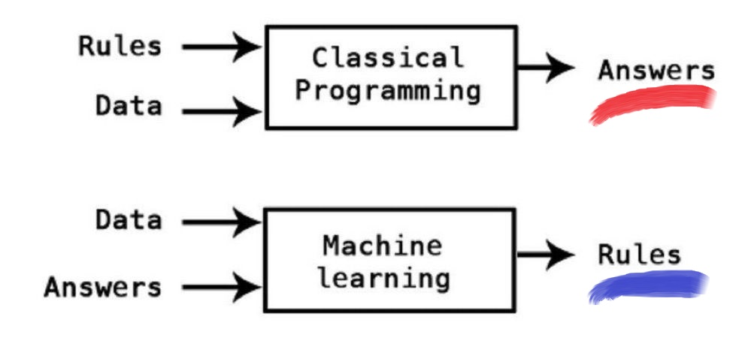
I. Data Exploration in Python
Difference between classical programming and machine learning/data science:

Slide 4
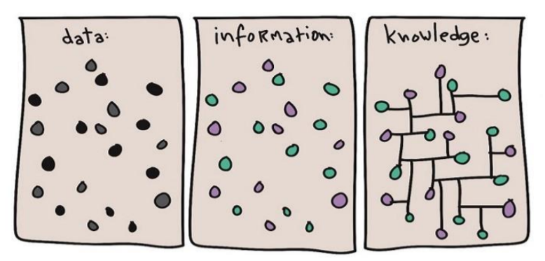
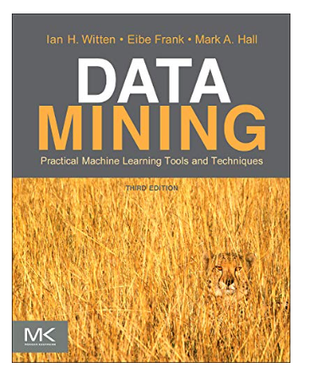
I. Data Exploration in Python
Our job as a data scientist: Finding relationships in data. We can also see the difference between data, information, and knowledge from the following illustration.
Finding relationships:
Finding visual relationship: Lion

Slide 5
I. Data Exploration in Python
What is clustering?
Clustering is “the process of organizing objects into groups whose members are similar in some way”.
Clustering can be considered the most important unsupervised learning technique; so, as every other problem of this kind, it deals with finding a structure in a collection of unlabeled data.
Major existing clustering methods:
Distance-based
Hierarchical
Partitioning
Probabilistic

Slide 6
I. Data Exploration in Python
Why do we need clustering?
Simplifications
Pattern detection
Dimensionality reduction
Useful in data concept construction
Unsupervised learning process
Labeling can be expensive
Gain insight into the structure of the data
Find prototypes in the data

Slide 7
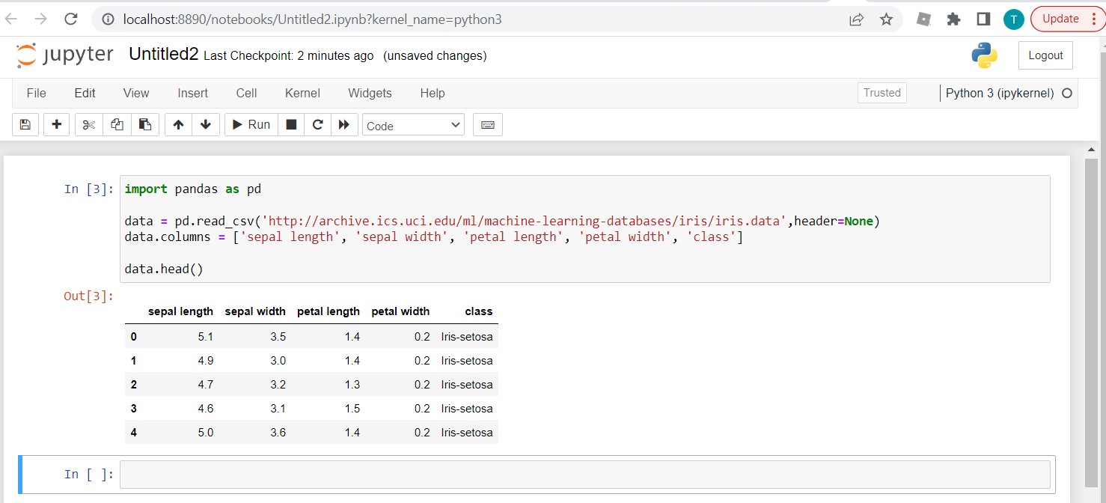
I. Data Exploration in Python
Example: Download the Iris data set from the UCI machine learning repository (online). Use Pandas to read the CSV file and store them in a DataFrame (DF) object named data. Display first few rows of the data frame.

Slide 8
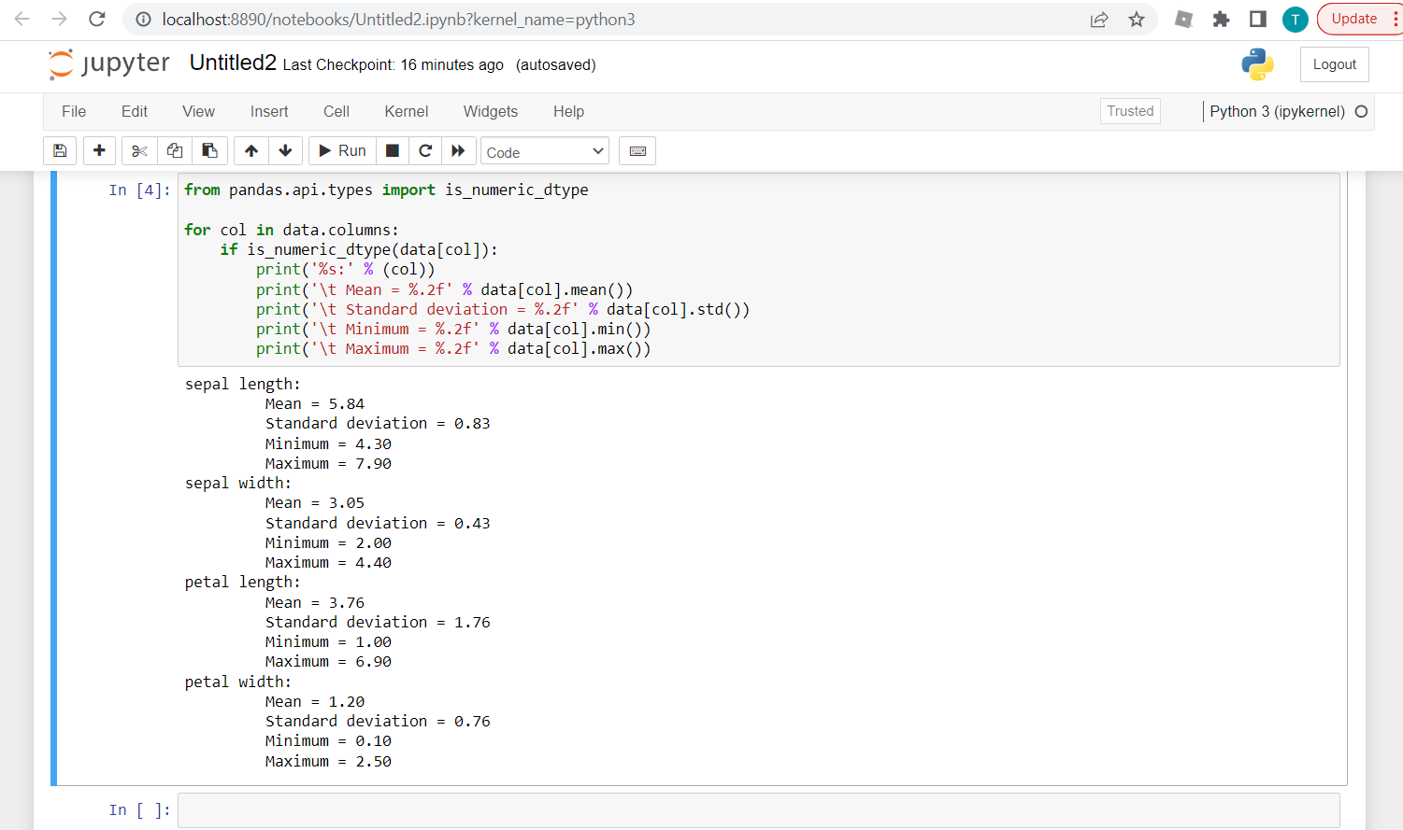
I. Data Exploration in Python
Example: For the Iris data set: For each quantitative attribute (sepal length, sepal width, petal length,
and petal width) calculate its average, standard deviation, minimum, and maximum values.

Slide 9
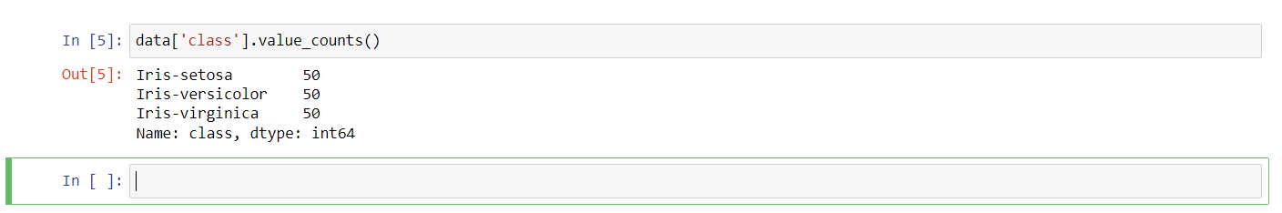
I. Data Exploration in Python
Example: For the Iris data set: For each qualitative attribute (class), count the frequency for each of its
distinct values.

Slide 10
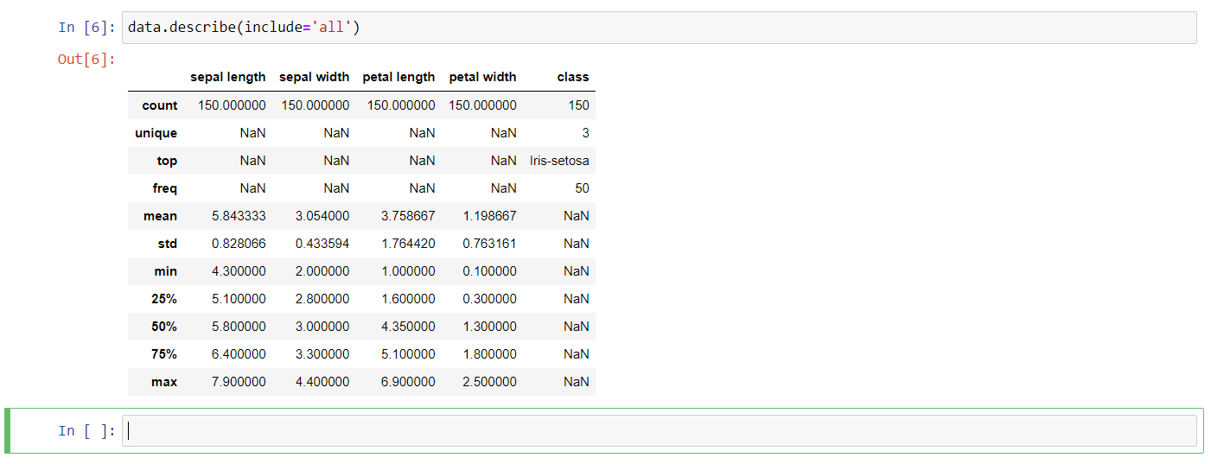
I. Data Exploration in Python
Information: describe() function
If an attribute is quantitative, it displays its mean, standard deviation and various quantiles (including minimum, median, and maximum) values. If an attribute is qualitative, it will display its number of unique values and the top (most frequent) values.
Example: For the Iris data set: Display the summary for all the attributes simultaneously in a table using
the describe() function.

Slide 11
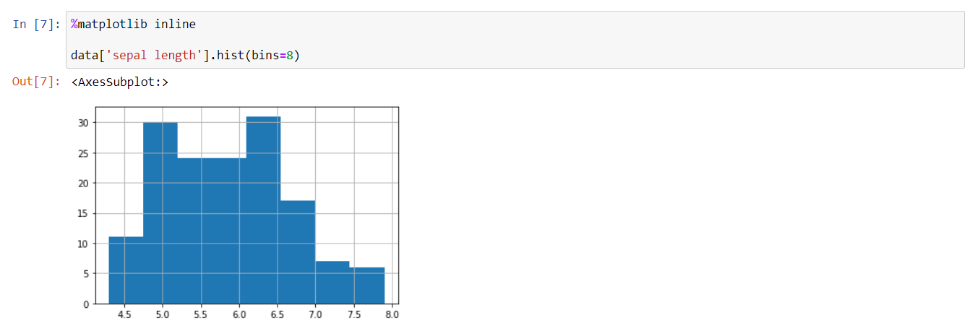
I. Data Exploration in Python
Example: For the Iris data set: Display the histogram for the sepal length attribute by discretizing it into
8 separate bins and counting the frequency for each bin.

Slide 12
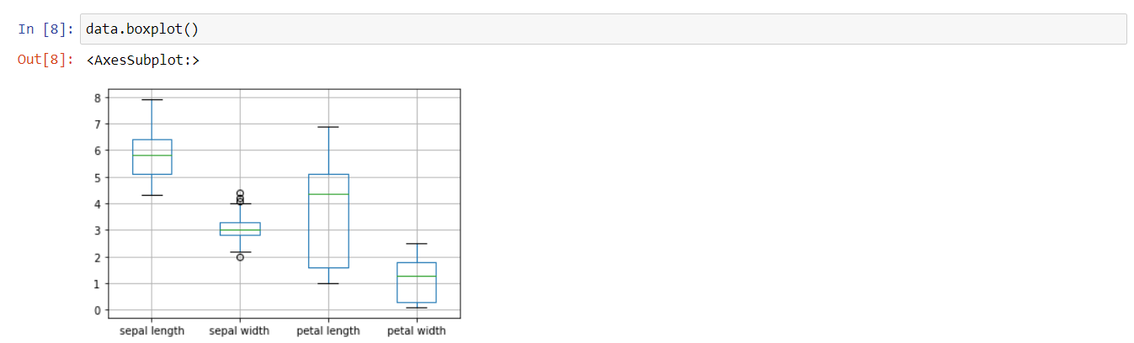
I. Data Exploration in Python
Example: For the Iris data set: Show the distribution of values for each attribute.

Slide 13
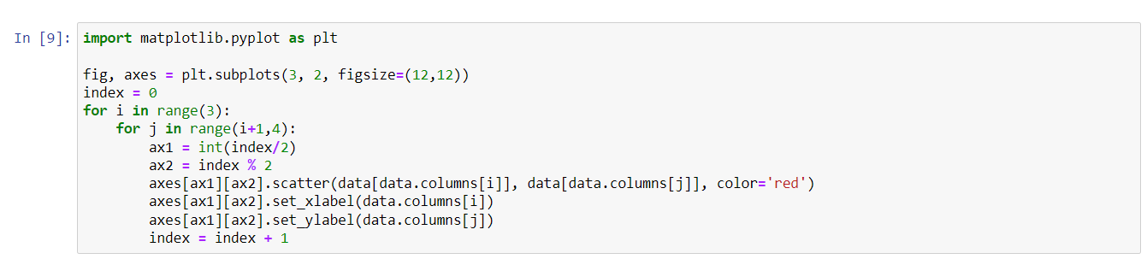
I. Data Exploration in Python
Example: For the Iris data set: For each pair of attributes, use a scatter plot to visualize
their joint distribution.

Slide 14
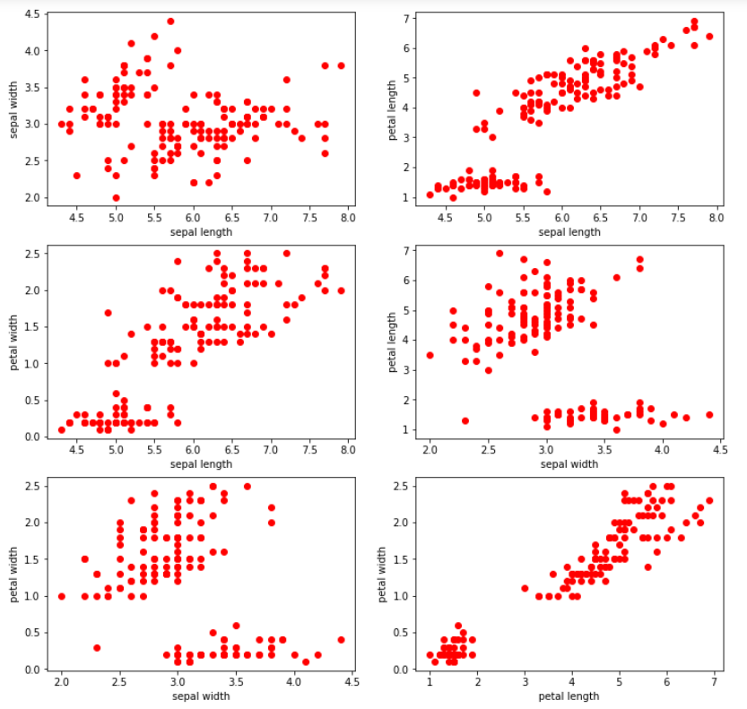
I. Data Exploration in Python
(Cont.): Output:

Slide 15
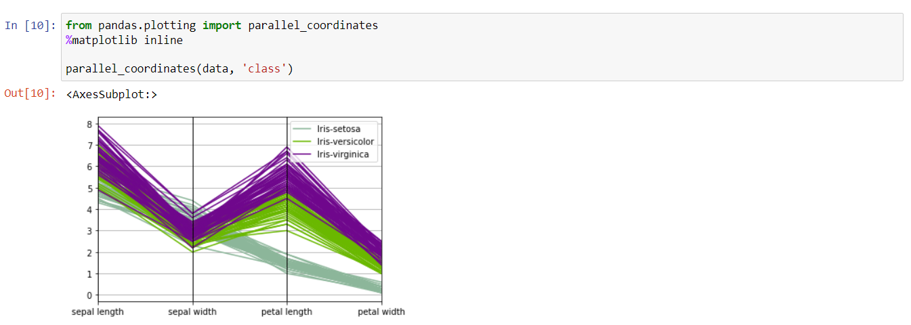
I. Data Exploration in Python
Example: Parallel coordinates can be used to display all the data points simultaneously. Parallel
coordinates have one coordinate axis for each attribute, but the different axes are parallel to
one other instead of perpendicular, as is traditional. Furthermore, an object is represented as a
line instead of as a point. In the following example, the distribution of values for each class can
be identified in a separate color.

Slide 16
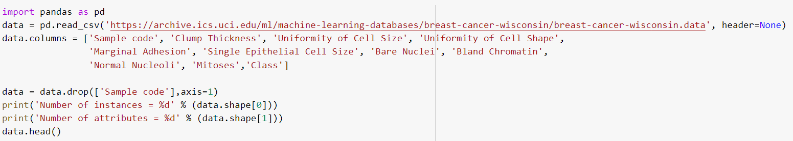
II. Data Preprocessing in Python
Poor data quality can have an adverse effect on data mining. Among the common data quality issues include noise, outliers, missing values, and duplicate data. This part presents examples of Python code to alleviate some of these data quality problems.
Example: We begin with an example dataset (Wisconsin Breast Cancer) from the UCI machine learning
repository containing information about breast cancer patients. We will first download the
dataset using Pandas read_csv() function and display its first 5 data points.

Slide 17
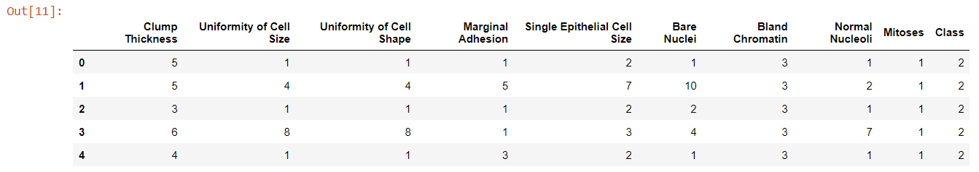
II. Data Preprocessing in Python
(Cont.) Output:

Slide 18
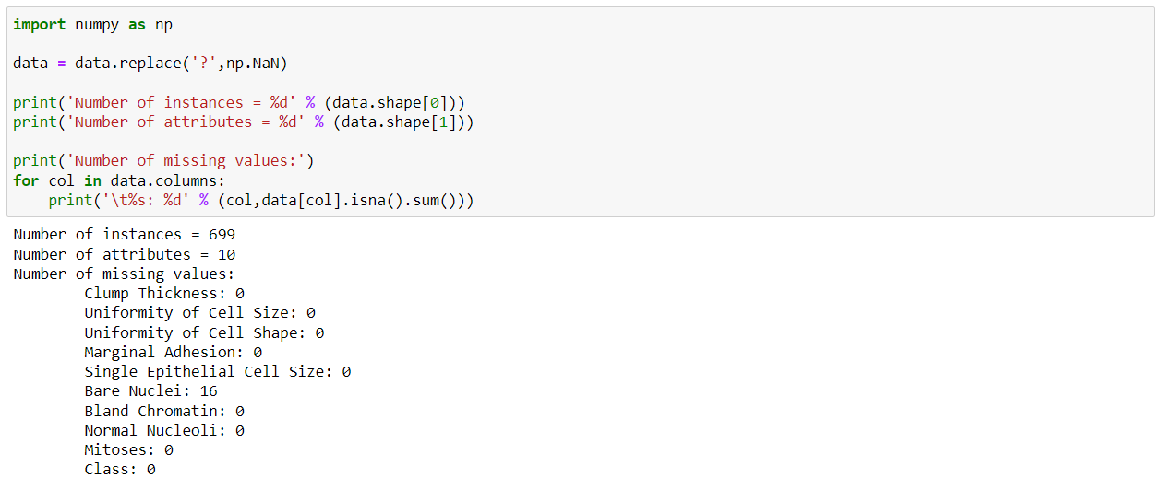
II. Data Preprocessing in Python
Example (Missing values): It is not unusual for an object to be missing one or more attribute values. In
some cases, the information was not collected; while in other cases, some attributes are inapplicable
to the data instances. This section presents examples on the different approaches for handling
missing values.
According to the description of the data (Wisconsin Breast Cancer) (https://archive.ics.uci.edu/ml/datasets/breast+cancer+wisconsin+(original), the missing values are encoded as '?' in the original data. Our first task is to convert the missing values to NaNs. We can then count the number of missing values in each column of the data.

Slide 19
II. Data Preprocessing in Python
(Cont.):

Slide 20
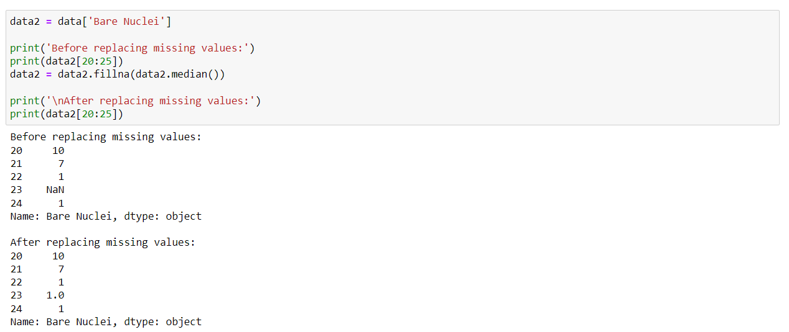
II. Data Preprocessing in Python
Example (Missing values): For the Wisconsin Breast Cancer data set: Observe that only the 'Bare Nuclei'
column contains missing values. In the following example, the missing values in the 'Bare
Nuclei' column are replaced by the median value of that column. The values before and after
replacement are shown for a subset of the data points.

Slide 21
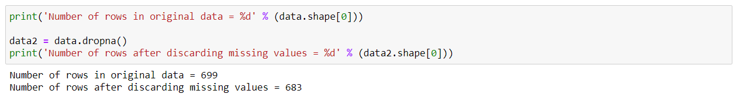
II. Data Preprocessing in Python
Example (Missing values): Instead of replacing the missing values, another common approach is to discard
the data points that contain missing values. This can be easily accomplished by applying the dropna()
function to the data frame.

Slide 22
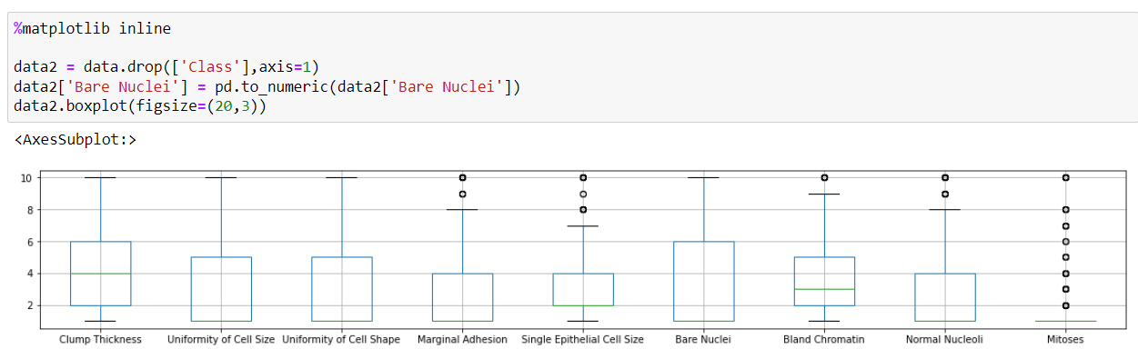
II. Data Preprocessing in Python
Example (Outliers): Outliers are data instances with characteristics that are considerably different from the rest of the dataset. In the example code below, we will draw a boxplot to identify the columns in the table that contain outliers. Note that the values in all columns (except for 'Bare Nuclei') for Wisconsin Breast Cancer data set are originally stored as 'int64' whereas the values in the 'Bare Nuclei' column are stored as string objects (since the column initially contains strings such as '?' for representing missing values). Thus, we must convert the column into numeric values first before creating the boxplot. Otherwise, the column will not be displayed when drawing the boxplot.

Slide 23
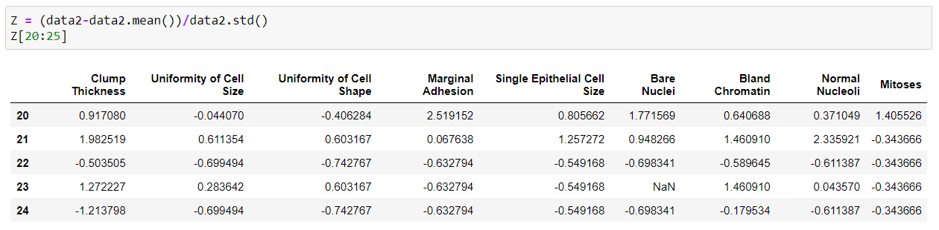
II. Data Preprocessing in Python
Example (Outliers): The boxplots suggest that only 5 of the columns (Marginal Adhesion, Single Epithetial Cell Size, Bland Cromatin, Normal Nucleoli, and Mitoses) contain abnormally high values. To discard the outliers, we can compute the Z-score for each attribute and remove those instances containing attributes with abnormally high or low Z-score (e.g., if Z > 3 or Z <= -3). For the Wisconsin Breast Cancer data set:
The following code shows the results of standardizing the columns of the data. Note that missing values (NaN) are not affected by the standardization process.

Slide 24
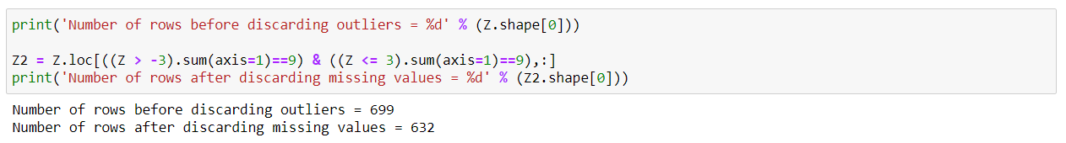
II. Data Preprocessing in Python
Example (Outliers): The following code shows the results of discarding columns with Z > 3 or Z <= -3.

Slide 25
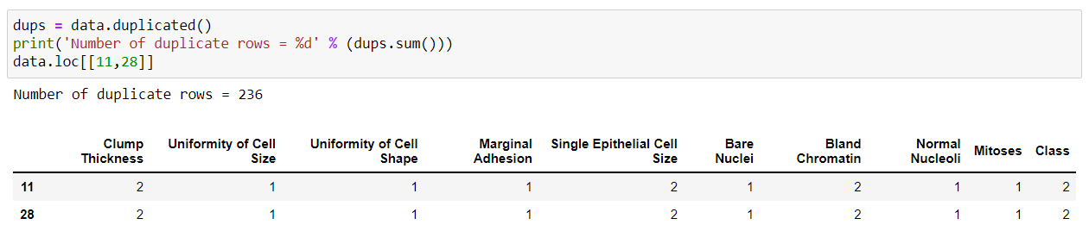
II. Data Preprocessing in Python
Example (Duplicate Data): Some datasets, especially those obtained by merging multiple data sources, may contain duplicates or near duplicate instances. The term deduplication is often used to refer to the process of dealing with duplicate data issues.
In the following example, we first check for duplicate instances in the Wisconsin Breast Cancer data set.

Slide 26
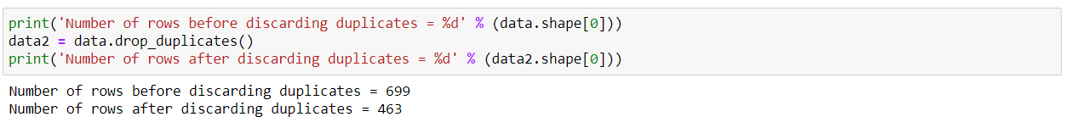
II. Data Preprocessing in Python
Example (Duplicate Data): The duplicated() function will return a Boolean array that indicates whether each row is a duplicate of a previous row in the table. The results suggest there are 236 duplicate rows in the breast cancer dataset. For example, the instance with row index 11 has identical attribute values as the instance with row index 28. Although such duplicate rows may correspond to samples for different individuals, in this hypothetical example, we assume that the duplicates are samples taken from the same individual and illustrate below how to remove the duplicated rows.

Slide 27
II. Data Preprocessing in Python
Example (Data Aggregation): Data aggregation is a preprocessing task where the values of two or more objects are combined into a single object. The motivation for aggregation includes (1) reducing the size of data to be processed, (2) changing the granularity of analysis (from fine-scale to coarser-scale), and (3) improving the stability of the data.
In the following example, we will use the daily precipitation time series data for a weather station located at Detroit Metro Airport. The raw data was obtained from the Climate Data Online website.
The daily precipitation time series will be compared against its monthly values.
The link to download data set: http://www.cse.msu.edu/~ptan/dmbook/tutorials/tutorial4/DTW_prec.csv
The code below will load the precipitation time series data and draw a line plot of its daily time series.

Slide 28
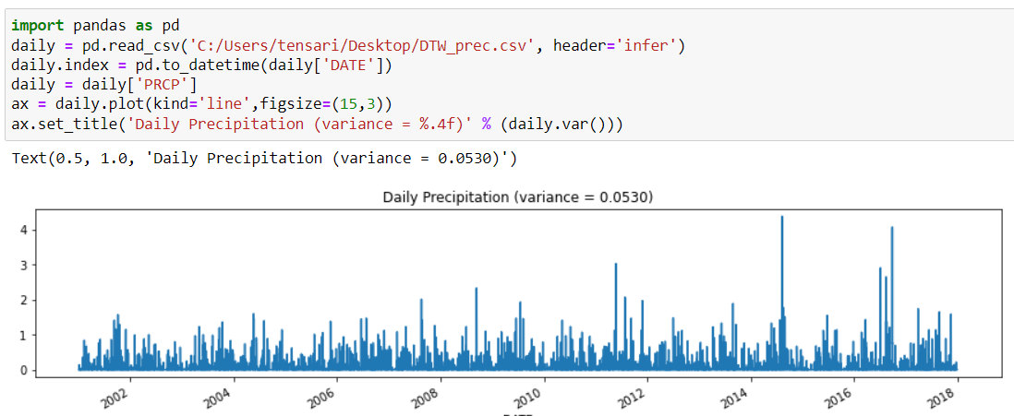
II. Data Preprocessing in Python
(Cont.):

Slide 29
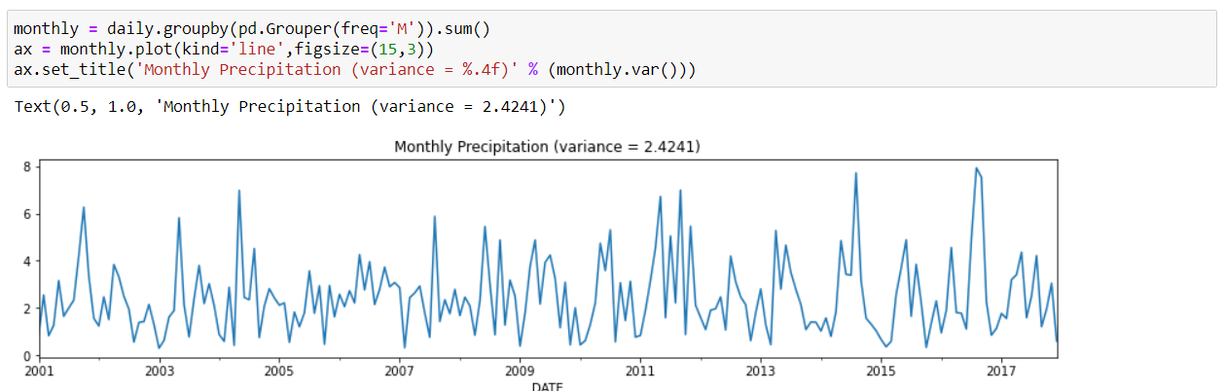
II. Data Preprocessing in Python
Example (Data Aggregation): Observe that the daily time series appear to be quite chaotic and varies significantly from one time step to another. The time series can be grouped and aggregated by month to obtain the total monthly precipitation values. The resulting time series appears to vary more smoothly compared to the daily time series.

Slide 30
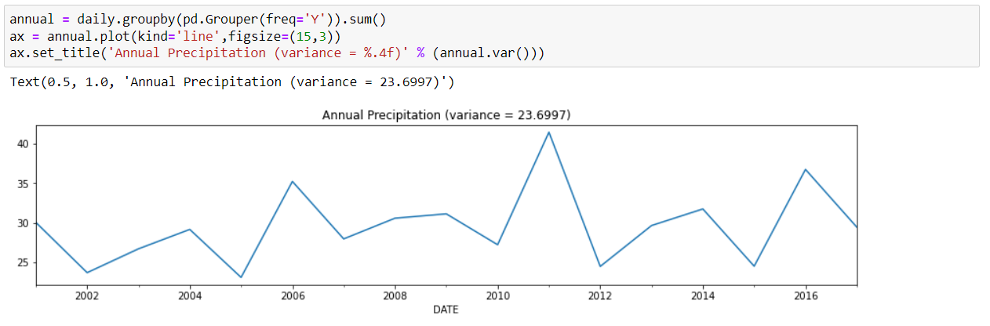
II. Data Preprocessing in Python
Example (Data Aggregation): In the example below, the daily precipitation time series are grouped and
aggregated by year to obtain the annual precipitation values.

Slide 31
II. Data Preprocessing in Python
Example (Data Sampling):
Sampling is an approach commonly used to facilitate (1) data reduction for exploratory data analysis and scaling up algorithms to big data applications and (2) quantifying uncertainties due to varying data distributions. There are various methods available for data sampling, such as sampling without replacement, where each selected instance is removed from the dataset, and sampling with replacement, where each selected instance is not removed, thus allowing it to be selected more than once in the sample.
In the following example, we will apply sampling with replacement and without replacement to the Wisconsin breast cancer dataset obtained from the UCI machine learning repository.

Slide 32
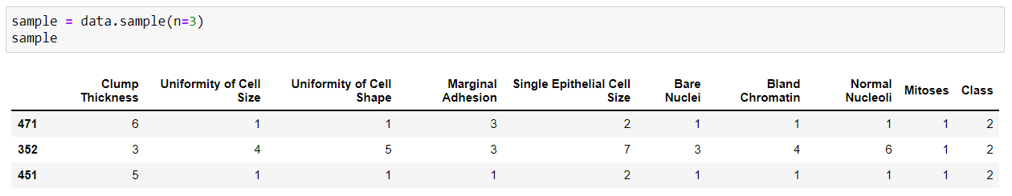
II. Data Preprocessing in Python
(Cont.):
We initially display the first five records of the table.
In the following code, a sample of size 3 is randomly selected (without replacement) from the original data.

Slide 33
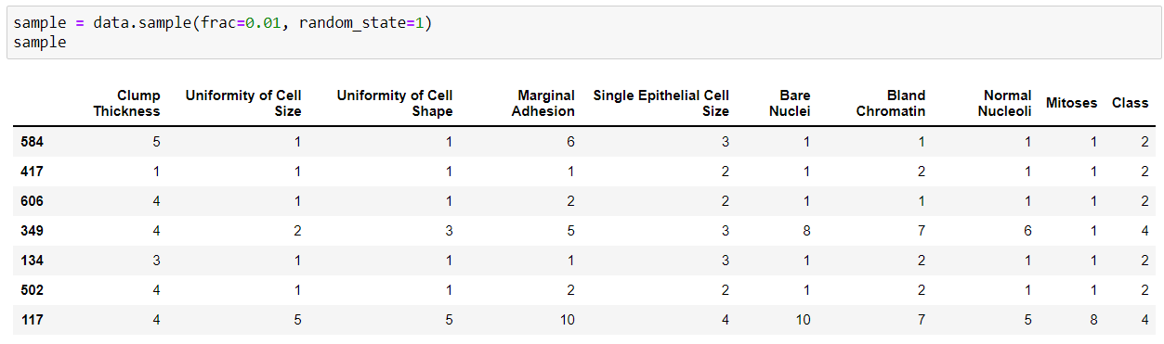
II. Data Preprocessing in Python
Example (Data Sampling): In this example, we randomly select 1% of the data (without replacement) and display the selected samples. The random_state argument of the function specifies the seed value of the random number generator.

Slide 34
II. Data Preprocessing in Python
Example (Data Discretization):
Discretization is a data preprocessing step that is often used to transform a continuous-valued attribute to a categorical attribute. The example below illustrates two simple but widely-used unsupervised discretization methods (equal width and equal depth) applied to the 'Clump Thickness' attribute of the breast cancer dataset.
First, we plot a histogram that shows the distribution of the attribute values. The value_counts() function can also be applied to count the frequency of each attribute value.

Slide 35
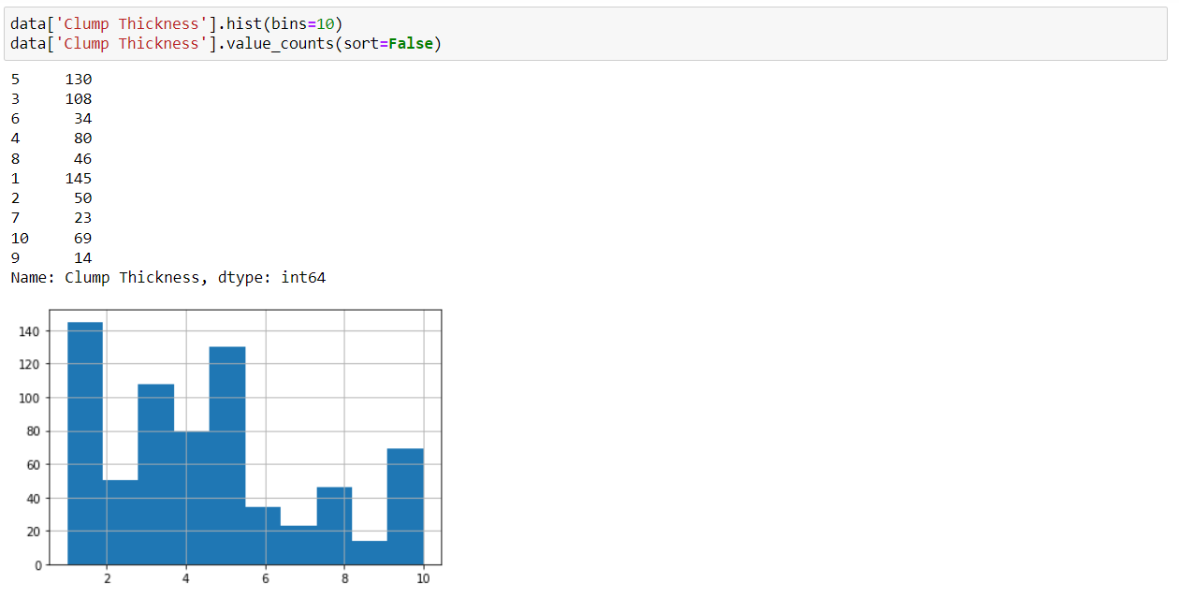
II. Data Preprocessing in Python
(Cont.):

Slide 36
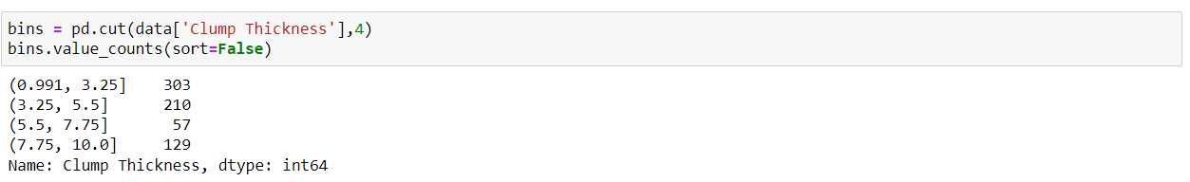
II. Data Preprocessing in Python
Example (Data Discretization):
For the equal width method, we can apply the cut() function to discretize the attribute into 4 bins of similar interval widths. The value_counts() function can be used to determine the number of instances in each bin.

Slide 37
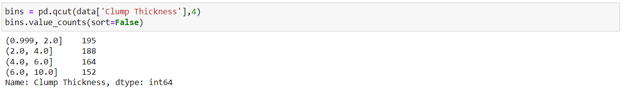
II. Data Preprocessing in Python
Example (Data Discretization): For the equal frequency method, the qcut() function can be used to partition the values into 4 bins such that each bin has nearly the same number of instances.

Slide 38
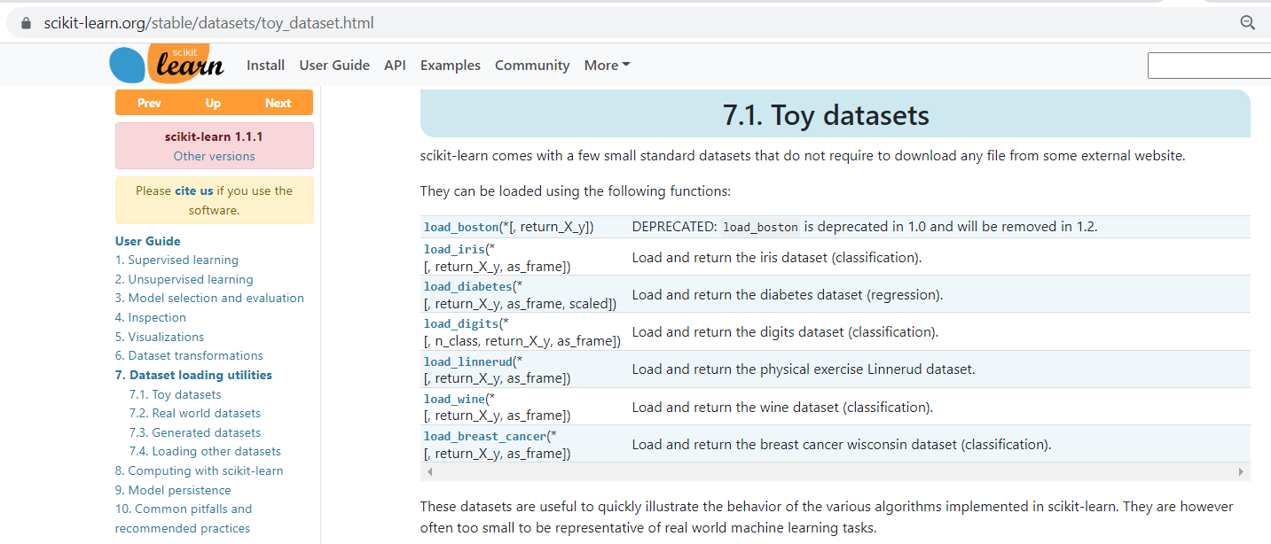
II. Data Preprocessing in Python
Scikit-Learn Toy Data Sets: They are useful to download from the library immediately.

Slide 39
III. Clustering Algorithms
A. Principal Component Analysis (PCA):
Principal component analysis (PCA) is a classical statistical method for reducing the number of attributes in the data by projecting the data from its original high-dimensional space into a lower-dimensional space.
The new attributes (also known as components) created by PCA have the following properties:
(1) They are linear combinations of the original attributes,
(2) They are orthogonal (perpendicular) to each other, and
(3) They capture the maximum amount of variation in the data.

Slide 40
III. Clustering Algorithms
Motivation:
Clustering
One way to summarize a complex real-valued data point with a single categorical variable
Dimensionality reduction
Another way to simplify complex high-dimensional data
Summarize data with a lower dimensional real valued vector
Given data points in d dimensions
Convert them to data points in r < d dimensions
With minimal loss of information

Slide 41
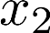
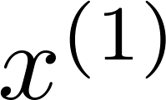
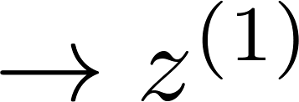
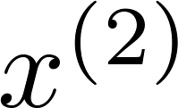
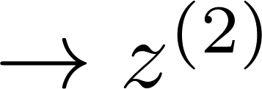
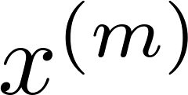
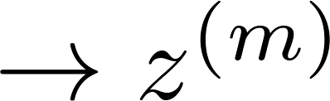
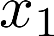
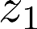
III. Clustering Algorithms
Reduce data from 2D to 1D
(inches)
(cm)
Data Compression
From Andrew Ng
Notes:
Add more unique colors (3-4)

Slide 42
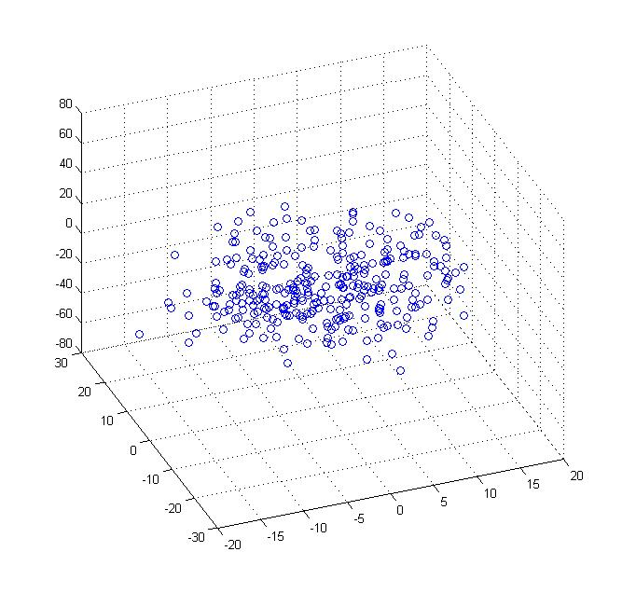
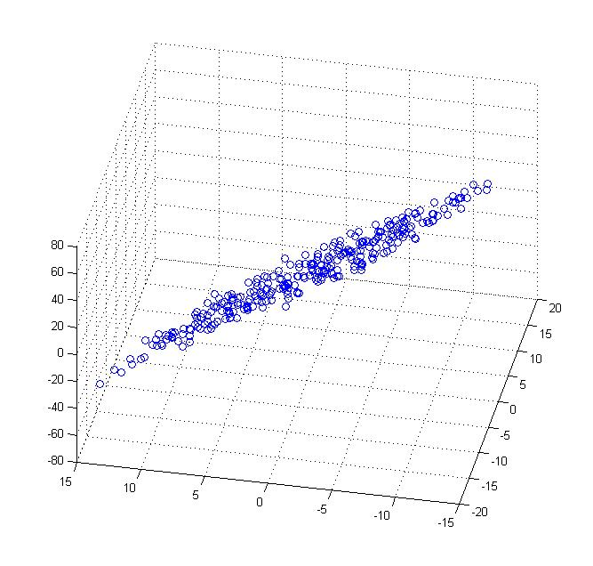
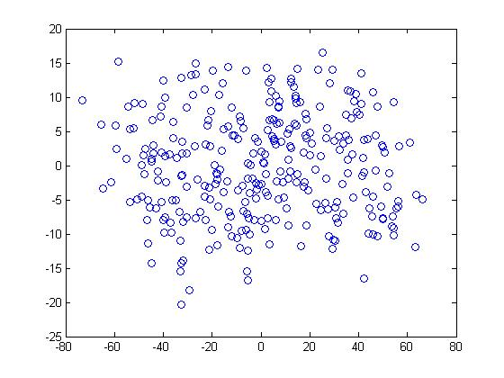
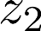
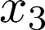
III. Clustering Algorithms
Data Compression:
Reduce data from 3D to 2D
From Andrew Ng
Notes:
Pca3d2d in lecture-slides/assets/pca/
Label axes

Slide 43
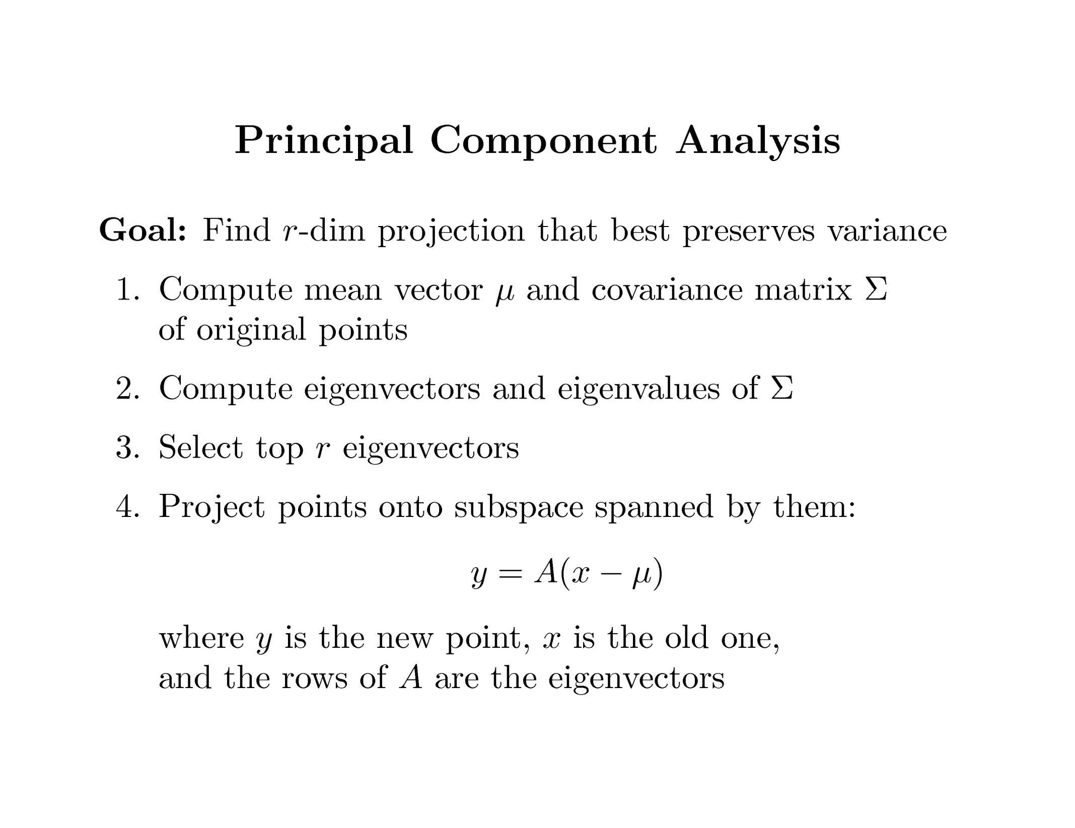
III. Clustering Algorithms
PCA algorithm steps:

Slide 44
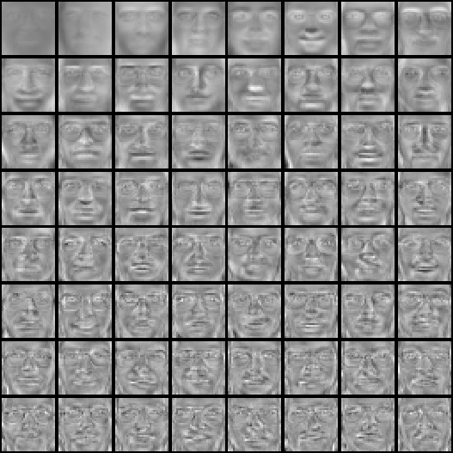

Example:
III. Clustering Algorithms
Top eigenvectors: u₁,…u_{k}
(visualized as an image - eigenfaces)
u₁
u₂
u₃
Mean face:
Notes:
44

Slide 45
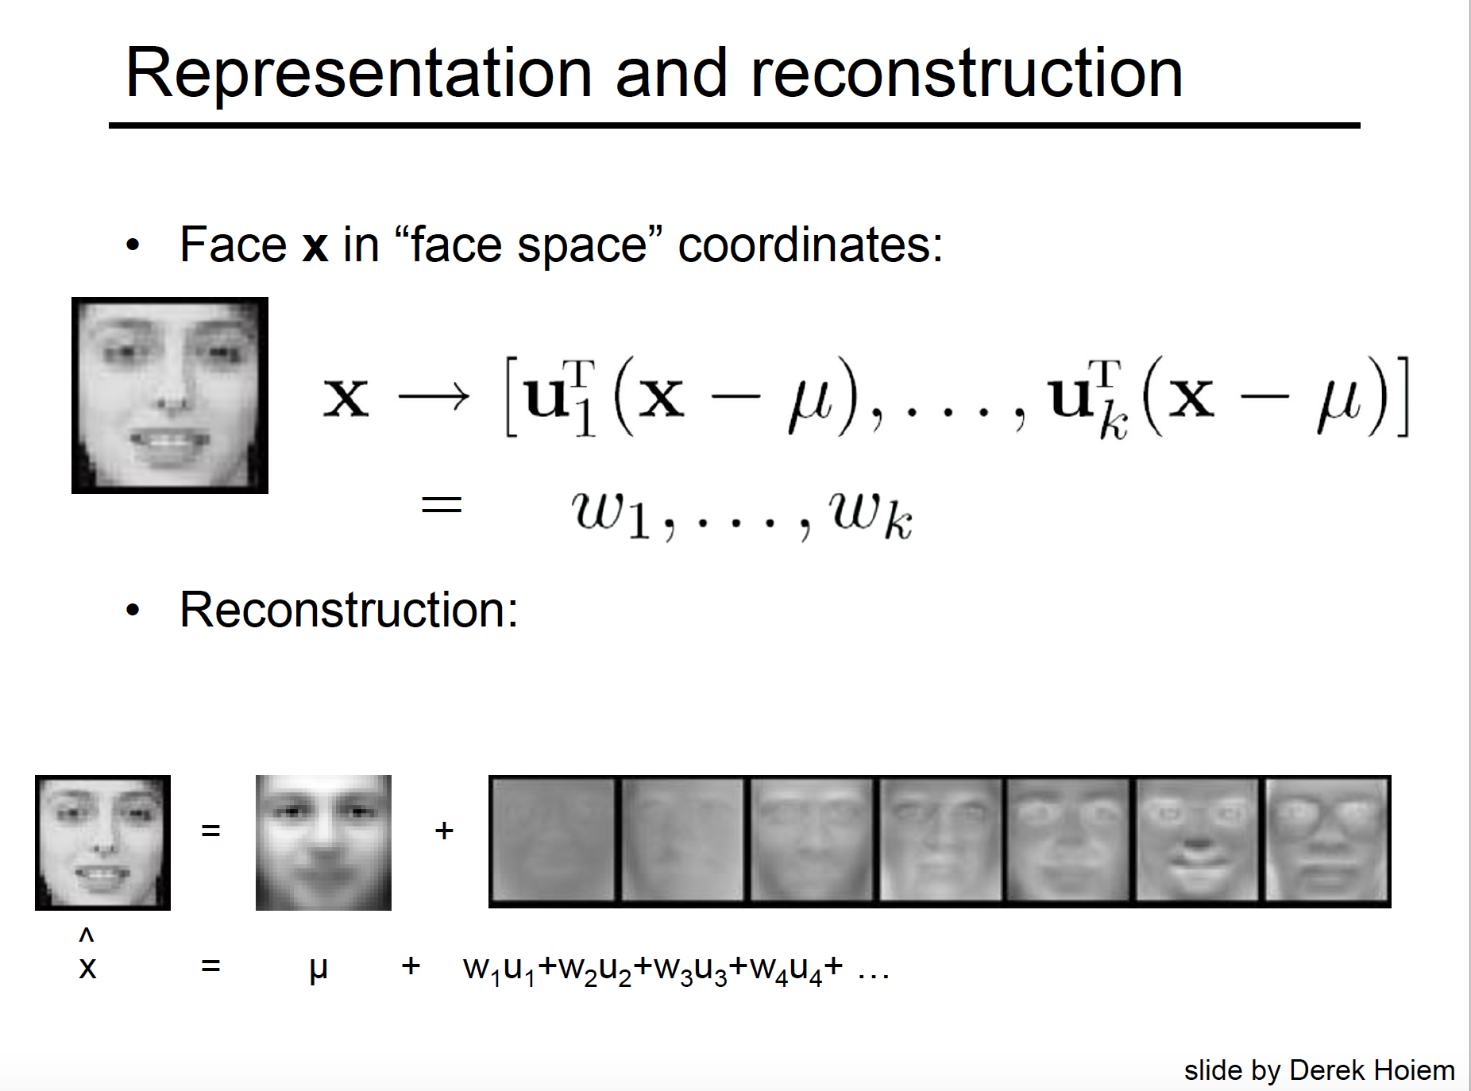
III. Clustering Algorithms

Slide 46
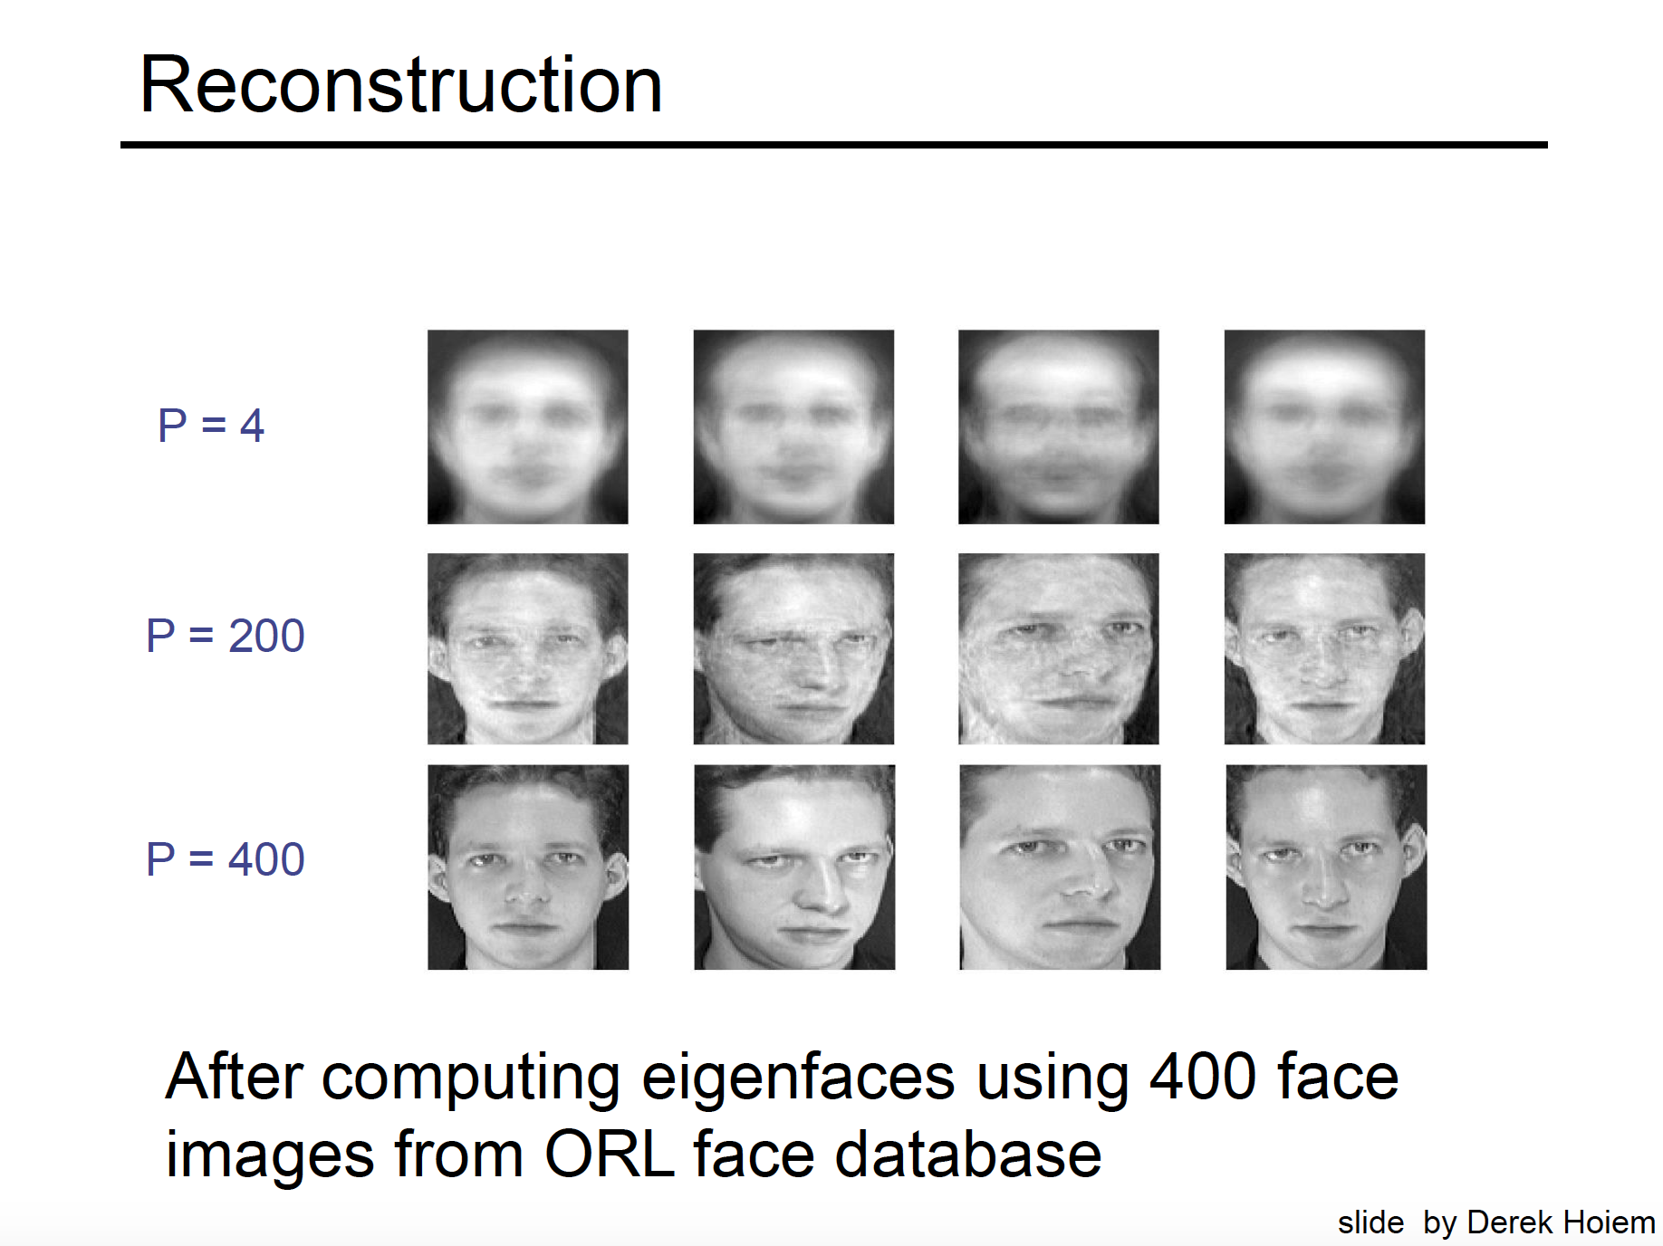
III. Clustering Algorithms

Slide 47
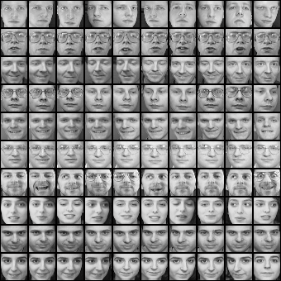
Example: There are 400 face images in the Olivetti Face Dataset (40 individuals and 10 different poses for each individual)
III. Clustering Algorithms
10 different face poses for the first person
Sample images from
the Olivetti Face Dataset
Notes:
47

Slide 48

III. Clustering Algorithms
III. Clustering Algorithms
Example 1: Using PCA algorithm manually in Python.

Slide 49

III. Clustering Algorithms
(Cont.) Output:

Slide 50
III. Clustering Algorithms
Example 2:
Download and unzip an image data set from the following link:
http://www.cse.msu.edu/~ptan/dmbook/tutorials/tutorial4/pics.zip
Principal component analysis (PCA) is a classical method for reducing the number of attributes in the data by projecting the data from its original high-dimensional space into a lower-dimensional space.
The new attributes (also known as components) created by PCA have the following properties: (1) they are linear combinations of the original attributes, (2) they are orthogonal (perpendicular) to each other, and (3) they capture the maximum amount of variation in the data.
The example below illustrates the application of PCA to an image dataset. There are 16 RGB files, each of which has a size of 111 x 111 pixels. The example code below will read each image file and convert the RGB image into a 111 x 111 x 3 = 36963 feature values. This will create a data matrix of size 16 x 36963.

Slide 51

III. Clustering Algorithms
(Cont.) Output:

Slide 52

III. Clustering Algorithms
(Cont.) Output:

Slide 53

III. Clustering Algorithms
Example 3: For the same an image data set: Using PCA, the data matrix is projected to its first two
principal components. The projected values of the original image data are stored in a pandas
DataFrame object named projected.

Slide 54

III. Clustering Algorithms
(Cont.): Output:

Slide 55

III. Clustering Algorithms
III. Clustering Algorithms
(Cont.): Finally, we draw a scatter plot to display the projected values. Observe that the images of
burgers, drinks, and pastas are all projected to the same region. However, the images for fried
chicken (shown as black squares in the diagram) are harder to discriminate.

Slide 56

III. Clustering Algorithms
Example 4 (The eigenfaces):
The goal of this example is to show how
an unsupervised method (PCA) can be
used a data set.

Slide 57

III. Clustering Algorithms
(Cont.): Note is that these faces have already been localized and scaled to a common size. This is an important preprocessing piece for facial recognition, and is a process that can require a large collection of training data. This can be done in scikit-learn, but the challenge is gathering a sufficient amount of training data for the algorithm to work. Fortunately, this piece is common enough that it has been done. One good resource is OpenCV, the Open Computer Vision Library.
We’ll also do a typical train-test split on the images to make it ready for the future (classification) studies.

Slide 58


III. Clustering Algorithms
(Cont.): 1850 dimensions can be a lot for a classification algorithms. So, we can use PCA to reduce these
1850 features to a manageable size, while maintaining most of the information in the dataset.
One interesting part of PCA is that it computes the “mean” face, which can be interesting to examine:

Slide 59


III. Clustering Algorithms
(Cont.): The principal components measure deviations about this mean along orthogonal axes.
It is also interesting to visualize these principal components:

Slide 60

III. Clustering Algorithms
(Cont.): The components (“eigenfaces”) are ordered by their importance from top-left to bottom-right. We see that the first few components seem to primarily take care of lighting conditions; the remaining components pull out certain identifying features: the nose, eyes, eyebrows, etc.
With this projection computed, we can now project our original training and test data onto the PCA basis:
These projected components correspond to factors in a linear combination of component images such that the combination approaches the original face.

Slide 61
III. Clustering Algorithms
B. K-Means Clustering:
The k-means algorithm is an algorithm to cluster n objects based on attributes into k partitions, where k < n.
It assumes that the object attributes form a vector space.

Slide 62

III. Clustering Algorithms
An algorithm for partitioning (or clustering) N data points into k disjoint
subsets S_{j} containing data points so as to minimize the sum-of-squares criterion
where x_{n} is a vector representing the the n^{th} data point and u_{j} is the
geometric centroid of the data points in S_{j}.

Slide 63

III. Clustering Algorithms
Graph (steps) of k-means algorithm:
From: Artificial Intelligence: Principles and Techniques, Stanford University

Slide 64
III. Clustering Algorithms
Simply speaking k-means clustering is an algorithm to classify or to group the objects based on attributes/features into k number of group.
k is positive integer number.
The grouping is done by minimizing the sum of squares of distances between data and the corresponding cluster centroid.

Slide 65

Flowchart of k-means algorithm:
III. Clustering Algorithms

Slide 66

Algorithmic steps of k-means algorithm:
III. Clustering Algorithms

Slide 67

III. Clustering Algorithms
Example: Apply k-means
Clustering algorithm for the
‘x’ and ‘y’ vectors (pairs).
You may use k=3.

Slide 68
IV. References
Introduction to Data Mining, Tan, Steinbach, Karpatne, Kumar.
Michigan State University, Data Mining, http://www.cse.msu.edu/~ptan/dmbook/software
- https://scipy-lectures.org/
- Artifical Intelligence: Principles and Techniques, Stanford University.
- Data Mining, Mu-Yu Lu, San Jose State University.
- Clustering, Jia-Bin Huang, Virginia Tech University.
- The Data Science Design Manual, S. S. Skiena, Springer, 2017.

